Slide 1
5. Graphs
Part 1

Slide 2
Objectives
2
Graph Introduction
Graph definition
Graph Terminology
Graph applications
Graph Representation
Graph Traversals
Shortest Paths
Dijsktra algorithm
Floyd algorithm

Slide 3

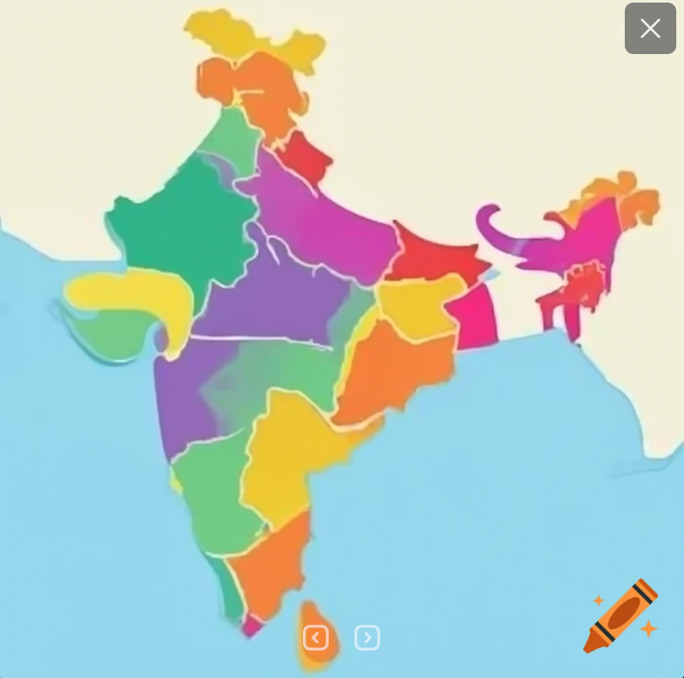
Graph Introduction
Graphs have applications in modeling many fields.
This notion of a “graph” should not be confused with bar charts and function plots, as these kinds of “graphs” are unrelated to the topic of this chapter.
3
Map coloring
computer networks
Data Structures and Algorithms in Java
3/36
Notes:
Graph = đồ thị
Vertex = đỉnh = node
Edge = arcs = cung = cạnh
3

Slide 4
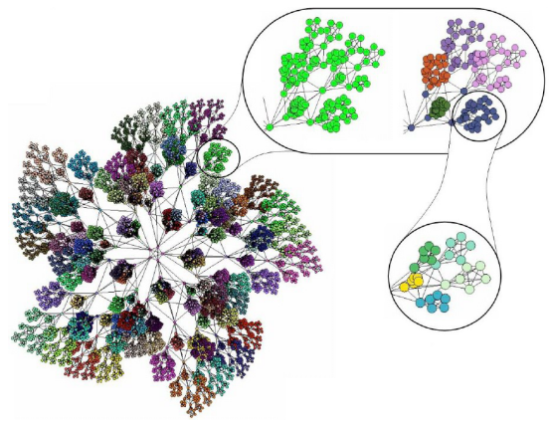
Graph Introduction
4
Graphs have applications in modeling many fields.
This notion of a “graph” should not be confused with bar charts and function plots, as these kinds of “graphs” are unrelated to the topic of this chapter.
Social network
Data Structures and Algorithms in Java
4/36
Notes:
Graph = đồ thị
Vertex = đỉnh = node
Edge = arcs = cung = cạnh
4

Slide 5
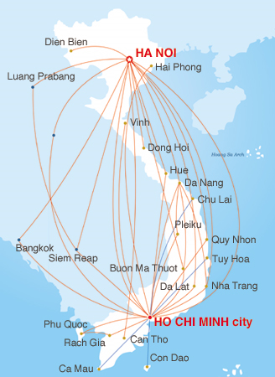
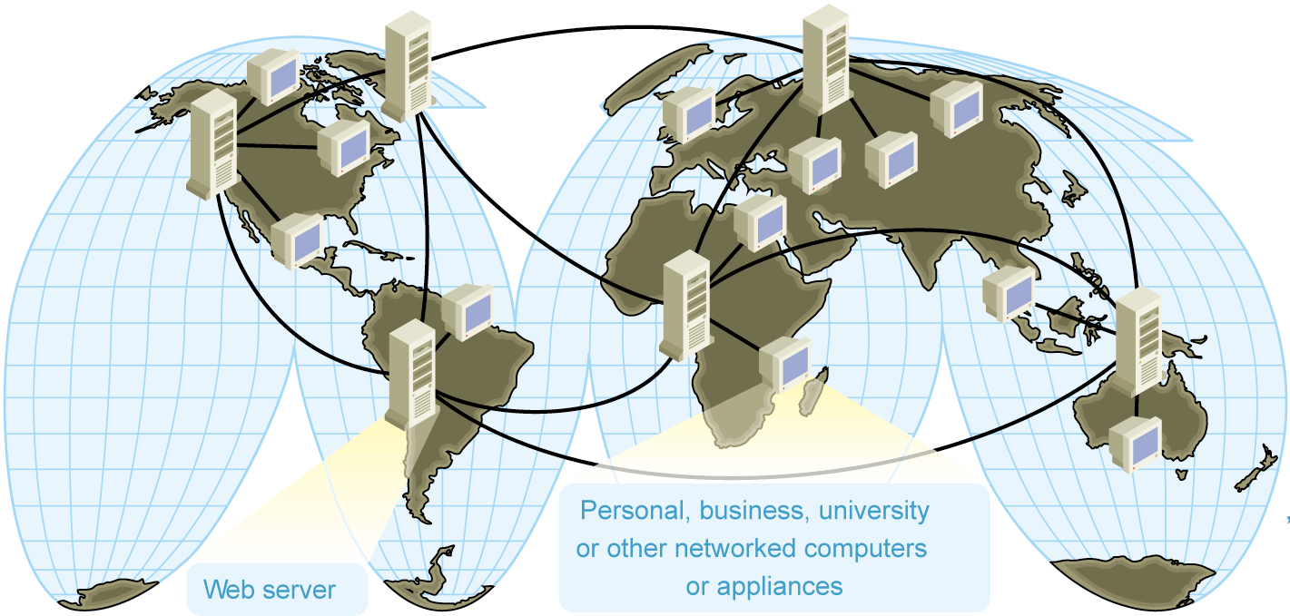
Graph applications
5
Computer networks
Database
Entity-relationship diagram
Notes:
Image source:
Computer network:http://www.microsoft.com/mspress/books/sampchap/4800/0735611874-01.gif
Air Flight map: http://www.vietnamairlines.com.vn
5

Slide 6
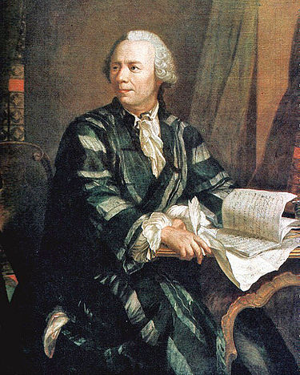

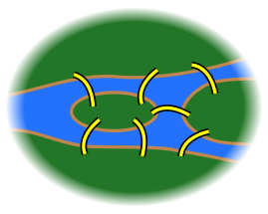
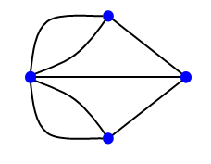
Graph Introduction
6
A graph is a way of representing relationships that exist between pairs of objects.
A graph is a set of objects, called vertices, together with a collection of pairwise connections between them, called edges.
Euler
Königsberg
Data Structures and Algorithms in Java
6/36
Notes:
Graph = đồ thị
Vertex = đỉnh = node
Edge = arcs = cung = cạnh
6

Slide 7
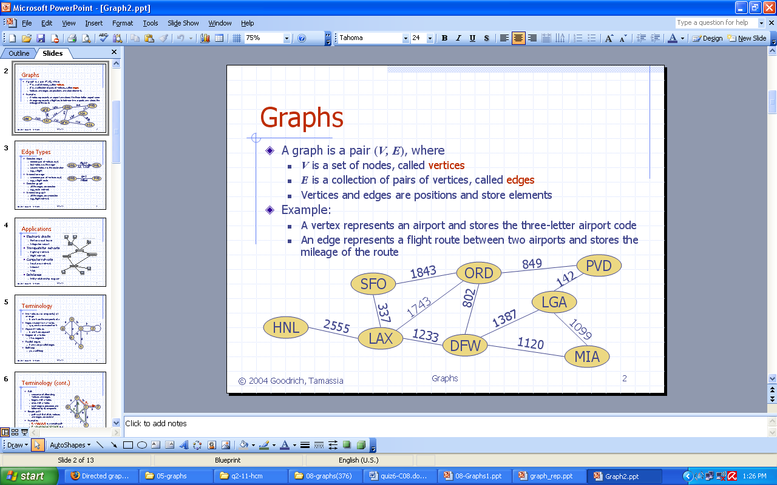
Graph definition
7
In briefly saying, a graph is a collection of
vertices and the connections between them
Notes:
Graph = đồ thị
Vertex = đỉnh = node
Edge = arcs = cung = cạnh
7

Slide 8
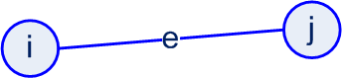
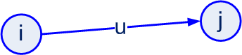
Graph Terminology
Edges in a graph are either directed or undirected. An edge (u,v) is said to be directed from u to v if the pair (u,v) is ordered, with u preceding v. An edge (u,v) is said to be undirected if the pair (u,v) is not ordered. Undirected edges are sometimes denoted with set notation, as {u,v}.
8
Undirected edge
Directed edge
Data Structures and Algorithms in Java
8/36
Notes:
Graph = đồ thị
Vertex = đỉnh = node
Edge = arcs = cung = cạnh
8

Slide 9
Graph Terminology
If all the edges in a graph are undirected, then we say the graph is an undirected graph. Likewise, a directed graph, also called a digraph, is a graph whose edges are all directed. A graph that has both directed and undirected edges is often called a mixed graph.
9
A
A
A
u₄
e₁
e₄
e₁
e₄
u₁
u₂
e₂
D
e₂
u₃
D
B
e₃
B
e₃
D
B
u₆
e₅
e₆
e₆
u₅
C
e₅
C
C
H
_{P}
G
Note that an undirected or mixed graph can be converted into a directed graph by replacing every undirected edge (u,v) by the pair of directed edges (u,v) and (v,u). It is often useful, however, to keep undirected and mixed graphs represented as they are, for such graphs have several applications.
Data Structures and Algorithms in Java
9/36
Notes:
Graph = đồ thị
Vertex = đỉnh = node
Edge = arcs = cung = cạnh
9

Slide 10
Graph Terminology
Two vertices i and j are said to be adjacent if there is an edge whose end vertices are i and j. An edge is said to be incident to a vertex if the vertex is one of the edge’s endpoints.
10
The two vertices joined by an edge are called the end vertices (or endpoints) of the edge.
If an edge is directed, its first endpoint is its origin and the other is the destination of the edge.
Data Structures and Algorithms in Java
10/36
Notes:
Graph = đồ thị
Vertex = đỉnh = node
Edge = arcs = cung = cạnh
10

Slide 11
Graph Terminology
11
The outgoing edges of a vertex are the directed edges whose origin is that vertex.
The incoming edges of a vertex are the directed edges whose destination is that vertex.
The degree of a vertex v, denoted deg(v), is the number of incident edges of v.
If deg(u) = 0 then u is called isolated vertex.
The in-degree and out-degree of a vertex v are the number of the incoming and outgoing edges of v, and are denoted indeg(v) and outdeg(v), respectively.
Data Structures and Algorithms in Java
11/36
Notes:
Graph = đồ thị
Vertex = đỉnh = node
Edge = arcs = cung = cạnh
11

Slide 12
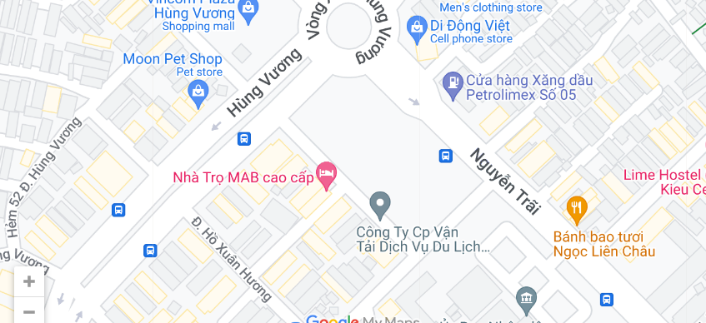
Graph Application
A city map can be modeled as a graph:
Vertices are intersections or dead ends,
Edges are stretches of streets without intersections
This graph has both undirected edges, which correspond to stretches of two-way streets, and directed edges, which correspond to stretches of one-way streets. Thus, in this way, a graph modeling a city map is a mixed graph.
12
Data Structures and Algorithms in Java
12/36
Notes:
Graph = đồ thị
Vertex = đỉnh = node
Edge = arcs = cung = cạnh
12

Slide 13
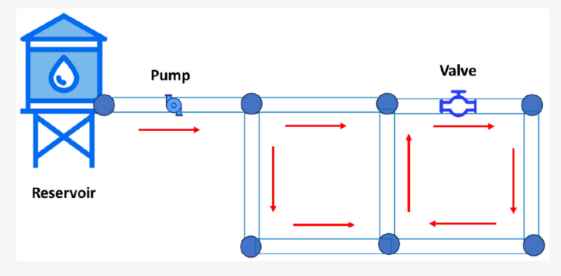
Graph Application
Physical examples of graphs are present in the electrical wiring and plumbing networks of a building.
Each connector, fixture, or outlet is viewed as a vertex,
Each uninterrupted stretch of wire or pipe is viewed as an edge.
Such graphs are actually components of much larger graphs, namely the local power and water distribution networks.
13
Data Structures and Algorithms in Java
13/36
Notes:
Graph = đồ thị
Vertex = đỉnh = node
Edge = arcs = cung = cạnh
13

Slide 14
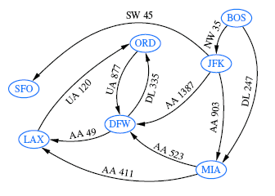
Graph Application
Air transportation by constructing a graph, called a flight network
Vertices are associated with airports,
Edges are associated with flights.
The edges are directed because a given flight has a specific travel direction.
The endpoints of an edge e correspond respectively to the origin and destination of the flight corresponding to e.
14
Two airports are adjacent if there is a flight that flies between them
Edge e is incident to a vertex v in G if the flight for e flies to or from the airport for v.
Data Structures and Algorithms in Java
14/36
Notes:
Graph = đồ thị
Vertex = đỉnh = node
Edge = arcs = cung = cạnh
14

Slide 15
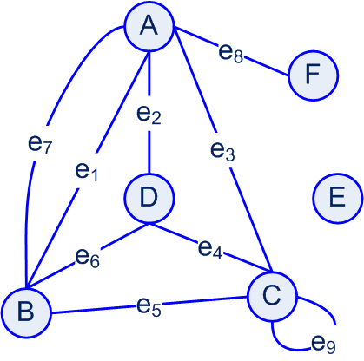
Graph Terminology
15
The definition of a graph refers to the group of edges as a collection, not a set, thus allowing:
Two undirected edges to have the same end vertices,
For two directed edges to have the same origin and the same destination.
Such edges are called parallel edges or multiple edges (e1, e7).
Data Structures and Algorithms in Java
15/36
Notes:
Graph = đồ thị
Vertex = đỉnh = node
Edge = arcs = cung = cạnh
15

Slide 16
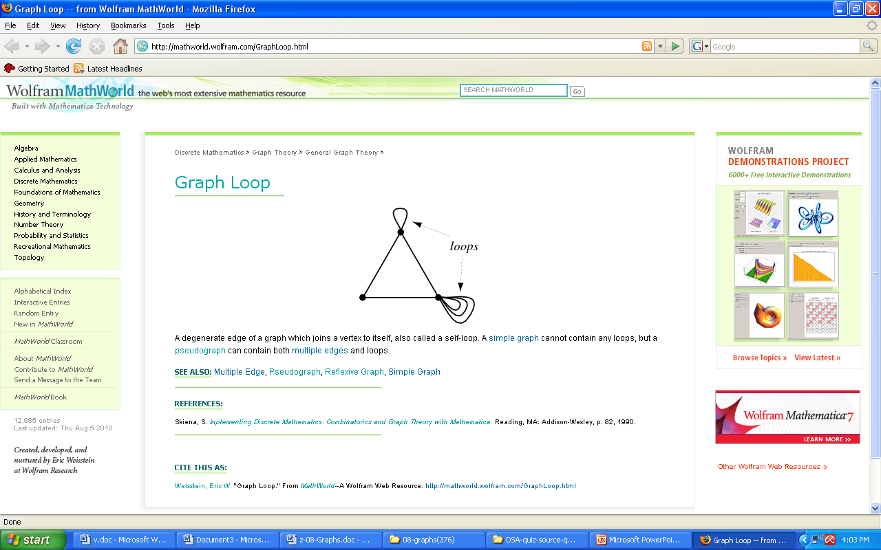
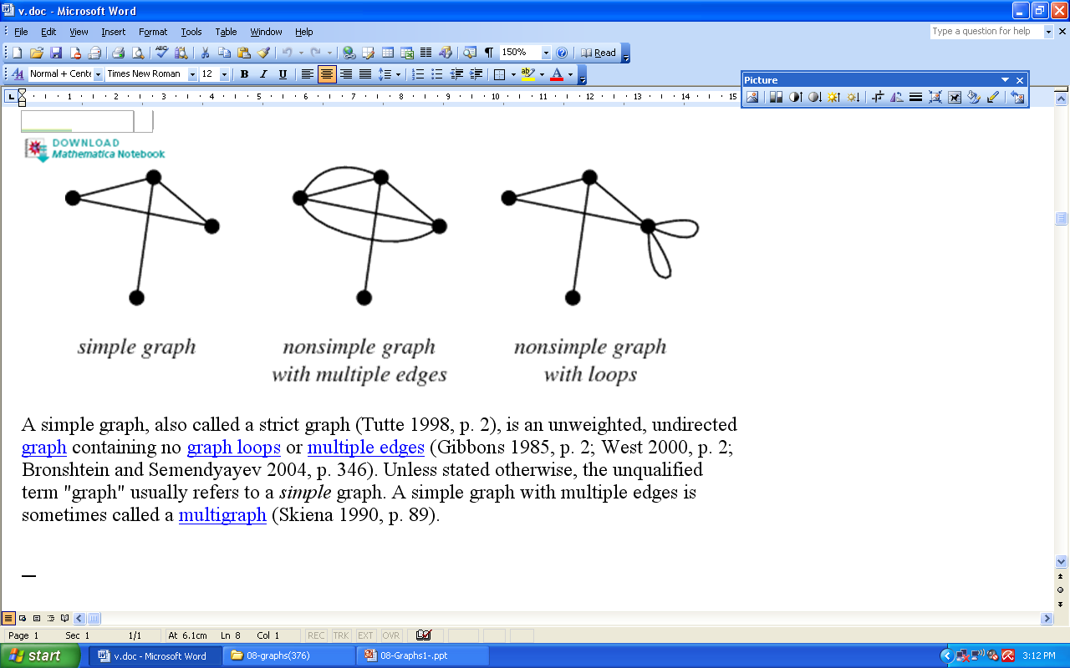
Graph Terminology
16
An edge (undirected or directed) is a self-loop if its two endpoints coincide.
A self-loop may occur in a graph associated with a city map, where it would correspond to a “circle” (a curving street that returns to its starting point).
Simple graphs do not have
parallel edges
self-loops.
The edges of a simple graph are a set of vertex pairs (and not just a collection)
Data Structures and Algorithms in Java
16/36
Notes:
Graph = đồ thị
Vertex = đỉnh = node
Edge = arcs = cung = cạnh
16

Slide 17
Graph Terminology
17
A graph is called multigraph if containing:
Multiple edges
No loops.
A graph is called Pseudograph if containing:
- Loops.
Data Structures and Algorithms in Java
17/36
Notes:
Graph = đồ thị
Vertex = đỉnh = node
Edge = arcs = cung = cạnh
17

Slide 18
Graph Terminology - 4
18
A path is a sequence of alternating vertices and edges that starts at a vertex and ends at a vertex such that each edge is incident to its predecessor and successor vertex.
A cycle is a path that starts and ends at the same vertex, and that includes at least one edge.
We say that a path is simple if each vertex in the path is distinct
We say that a cycle is simple if each vertex in the cycle is distinct, except for the first and last one.
A directed path is a path such that all edges are directed and are traversed along their direction. A directed cycle is similarly defined.
Data Structures and Algorithms in Java
18/36
Notes:
Graph = đồ thị
Vertex = đỉnh = node
Edge = arcs = cung = cạnh
18

Slide 19
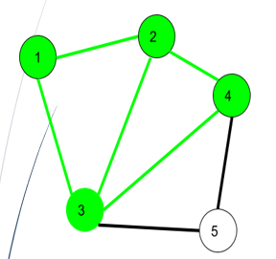
Graph Terminology - 4
19
Path:
1->2->3->4
1->2->3->4->2->1->3
Cycle:
2->3->4->2
1->2->3->4->2->3->1
Data Structures and Algorithms in Java
19/36
Notes:
Graph = đồ thị
Vertex = đỉnh = node
Edge = arcs = cung = cạnh
19

Slide 20
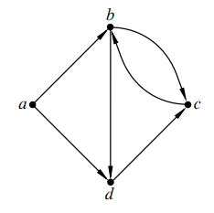
Graph Terminology - 4
Path: a->b->c->b->d
Simple path: a->b->d
Cycle: d->c->b->c->b->d
Simple cycle: b->d->c->b
If a graph is simple, we may omit the edges when describing path P or cycle C, as these are well defined, in which case P is a list of adjacent vertices and C is a cycle of adjacent vertices.

Slide 21
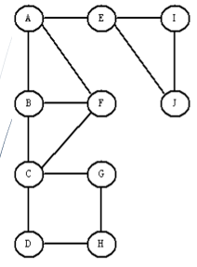
Graph Terminology - 5
21
A undirected graph G is connected if, for any two vertices, there is a path.
Data Structures and Algorithms in Java
21/36
Notes:
Graph = đồ thị
Vertex = đỉnh = node
Edge = arcs = cung = cạnh
21

Slide 22
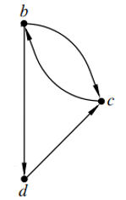
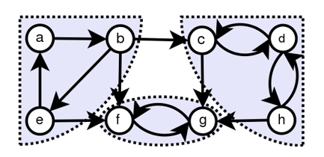
Graph Terminology - 5
22
A directed graph G is strongly connected if for any two vertices u and v, there is a directed path. A directed graph is called weakly connected if replacing all of its directed edges with undirected edges produces a connected (undirected) graph.
Data Structures and Algorithms in Java
22/36
Notes:
Graph = đồ thị
Vertex = đỉnh = node
Edge = arcs = cung = cạnh
22

Slide 23
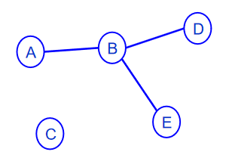
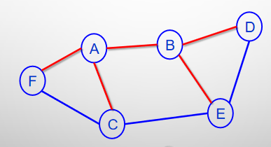
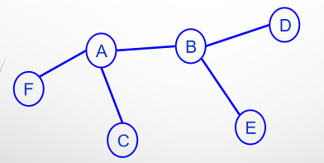
Graph Terminology - 5
A subgraph of a graph G is a graph H whose vertices and edges are subsets of the vertices and edges of G, respectively.
A spanning subgraph of G is a subgraph of G that contains all the vertices of the graph G. If a graph G is not connected,
23
Data Structures and Algorithms in Java
23/36
Notes:
Graph = đồ thị
Vertex = đỉnh = node
Edge = arcs = cung = cạnh
23

Slide 24
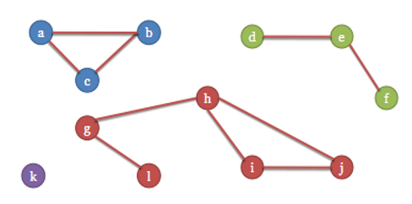
Graph Terminology - 5
24
Its maximal connected subgraphs are called the connected components of G.
Data Structures and Algorithms in Java
24/36
Notes:
Graph = đồ thị
Vertex = đỉnh = node
Edge = arcs = cung = cạnh
24

Slide 25
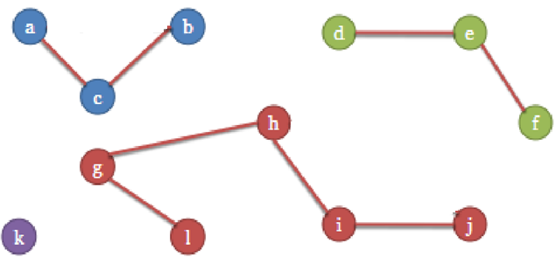
Graph Terminology - 5
A forest is a graph without cycles.
A tree is a connected forest, that is, a connected graph without cycles.
A spanning tree of a graph is a spanning subgraph that is a tree. (Note that this definition of a tree is somewhat different from the one given in Chapter 4, as there is not necessarily a designated root.)
25
Data Structures and Algorithms in Java
25/36
Notes:
Graph = đồ thị
Vertex = đỉnh = node
Edge = arcs = cung = cạnh
25

Slide 26

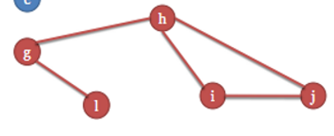
Graph Terminology - 6
If the vertex is removed from a graph (along with incident edges) and there is no way to find a path from a to b, then the graph is split into two separate subgraphs called articulation points, or cut-vertices
If an edge causes a graph to be split into two subgraphs, it is called a bridge or cut-edge
26
Data Structures and Algorithms in Java
26/36

Slide 27
Graph Terminology - 6
27
Connected subgraphs with no articulation points or bridges are called blocks
We can use depth first traverse to check the connectivity of a graph
Data Structures and Algorithms in Java
27/36

Slide 28
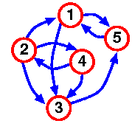
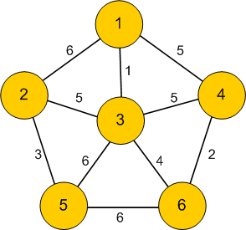
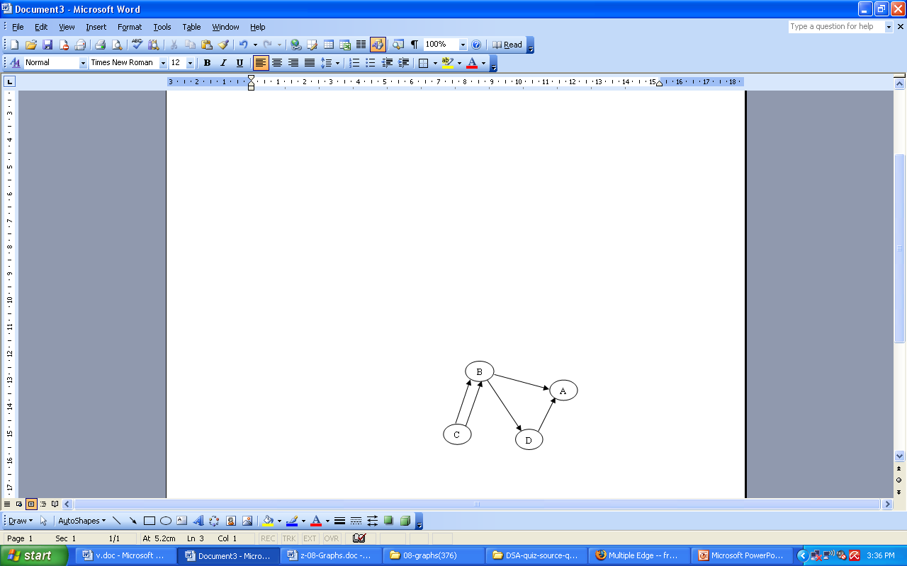
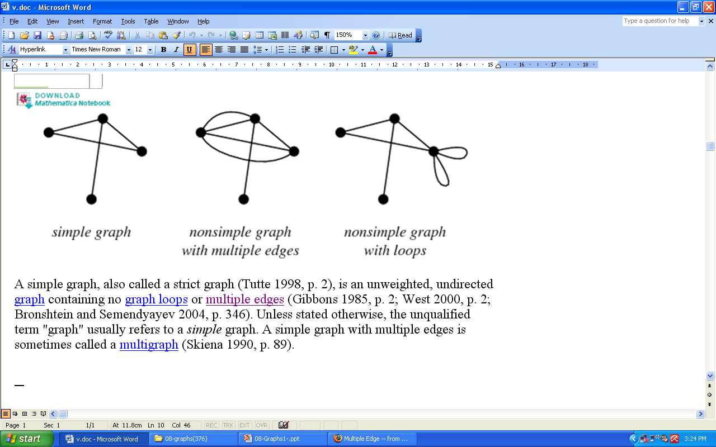
Graph Examples - 4
28
Weighted graph
Single Directed graph
An undirected graph with multiple edges
An directed graph with multiple edges
Notes:
Graph = đồ thị
Vertex = đỉnh = node
Edge = arcs = cung = cạnh
28

Slide 29
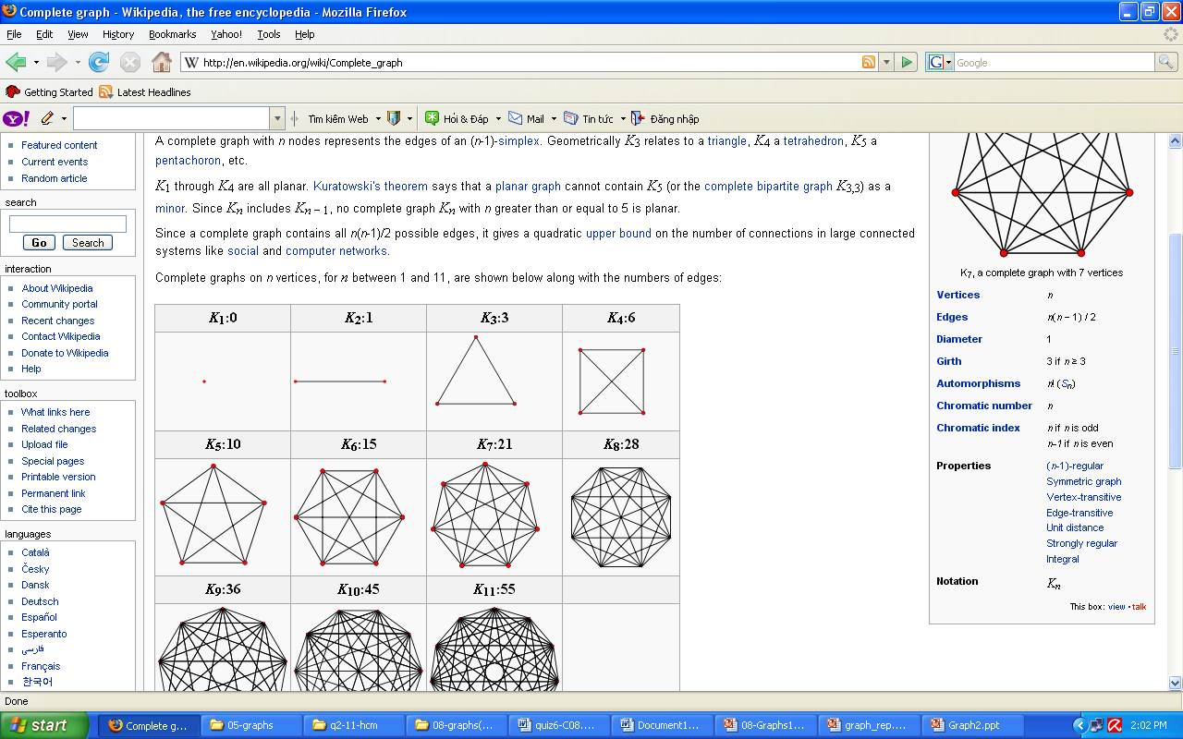
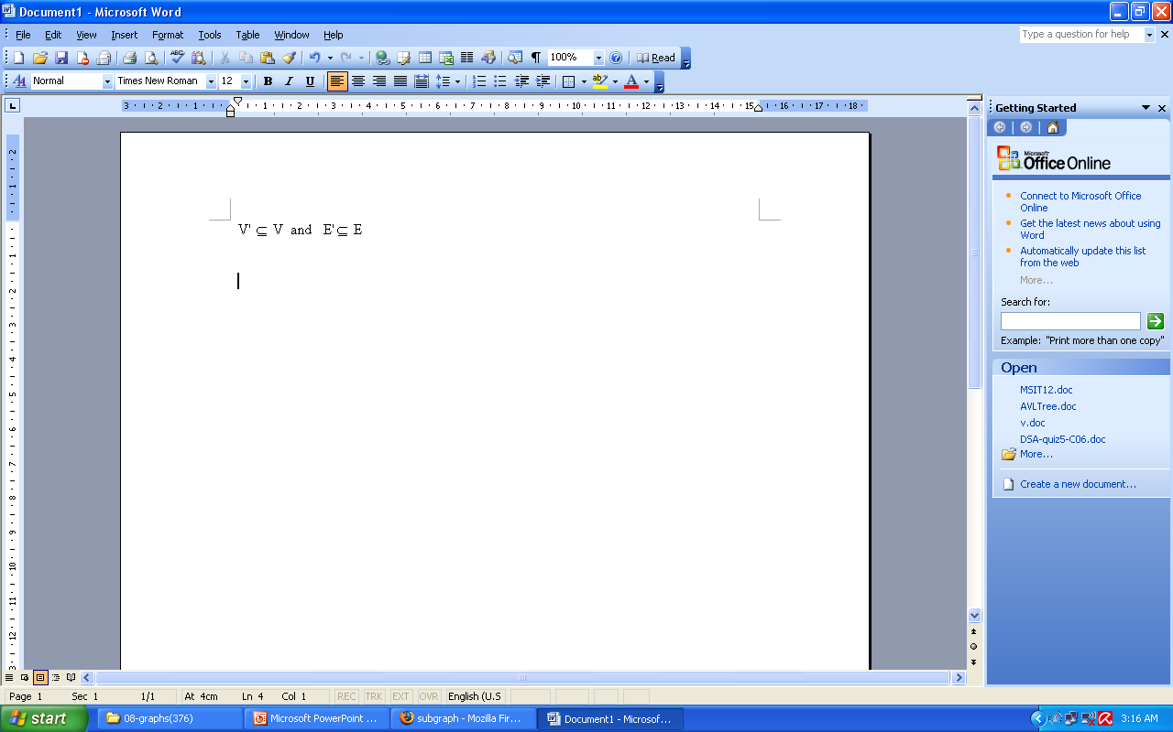
Graph Terminology - 7
29
A complete graph is a graph where every pair of vertices is connected by an edge.
A simple complete graph on n vertices has n vertices and n(n-1)/2 edges, and is denoted by Kn
A graph G'=(V', E') is a subgraph of another graph G=(V, E) iff V
Notes:
Cycle = chu trình
29

Slide 30
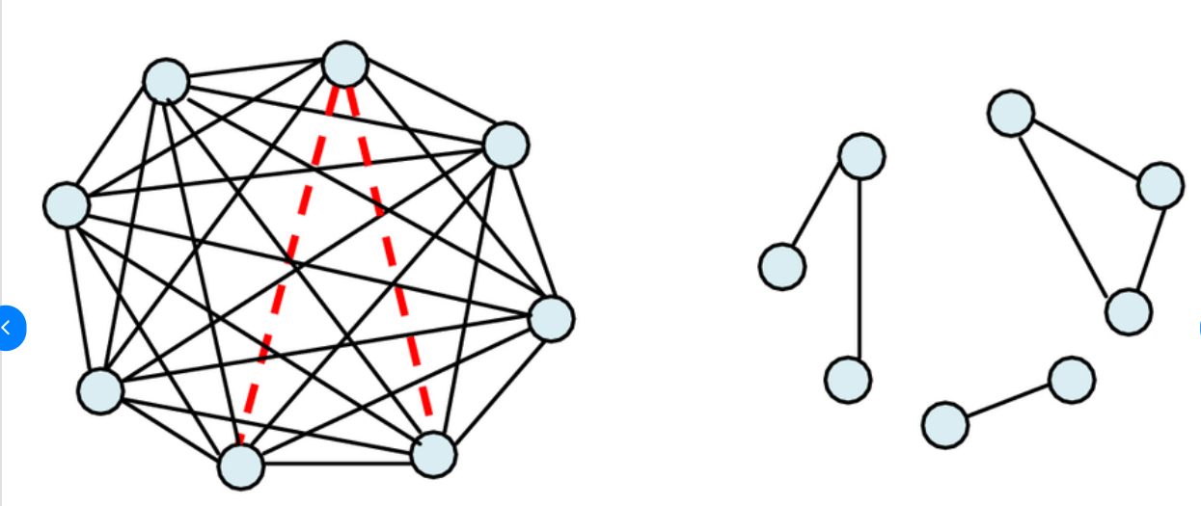
Graph Terminology - 7
30
Dense graph: A graph in which the number of edges is close to the possible number of edges.
Sparse graph: A graph in which the number of edges is much less than the possible number of edges.
Notes:
Cycle = chu trình
30

Slide 31
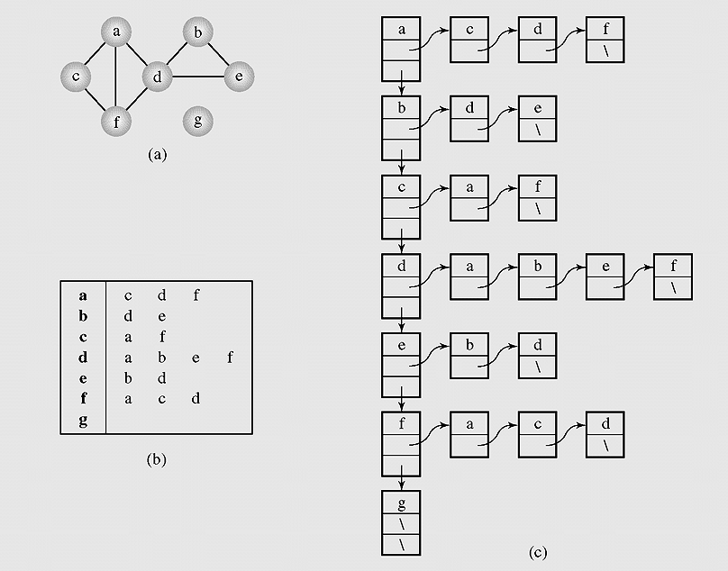
Graph Representation
(Adjacency list)
31
Graph representations.
A graph (a) can be represented as
(b–c) an adjacency list.
Notes:
Let them discuss how to implement, try some lines
31

Slide 32
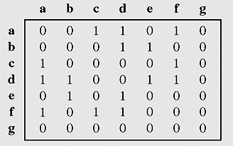
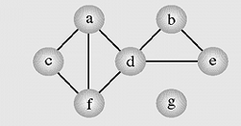
Graph Representation
(Adjacency matrix)
32
Graph represented by an adjacency matrix
Notes:
Build on papers
More: incident matrix = ma tran lien thuoc
32

Slide 33
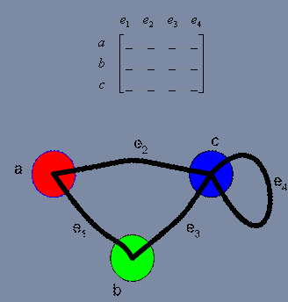
Graph Representation
(Incident matrix)
A vertex is said to be incident to an edge if the edge is connected to the vertex.
Graph represented by incident matrix
Notes:
Build on papers
More: incident matrix = ma tran lien thuoc
33

Slide 34
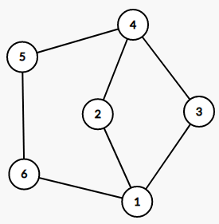
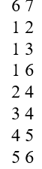
Graph Representation
(Edge list)
The 1st line: number of vertices, number of edges
From the 2nd line: each line is a edge, including two vertices
Notes:
Build on papers
More: incident matrix = ma tran lien thuoc
34

Slide 35
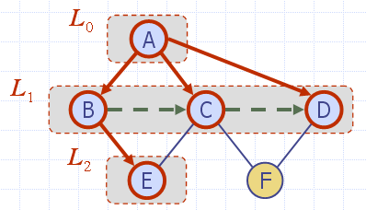
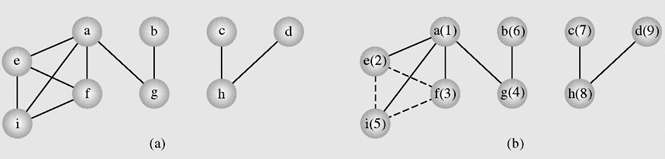
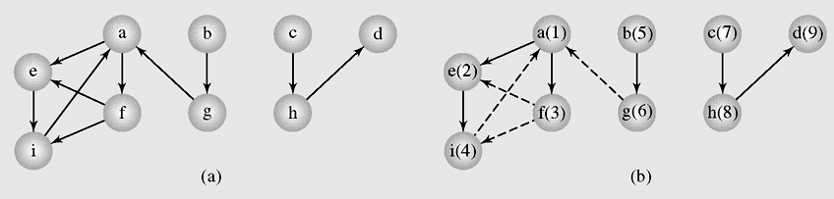
Breadth-first Search
Graph Traversals
In the breadth-first search algorithm, at first a selected vertex v is visited and then each unvisited vertex adjacent to v is visited. Suppose these adjacents are v₁ , v₂,… v_{k}. After all these vertices are visited, all adjacents of v₁ are visited, then all adjacents of v₂ are visited and so on. If there are still some unvisited vertices in the graph, the traversal continues restarting for one of the unvisited vertices.
35

Slide 36
Breadth-first Search Algorithm
Search a graph (directed or not) in breadth first, this is done by using a queue where the vertices found are stored.
36
BFS(Graph G)
{ all vertices of G are first painted white
the graph root is painted gray and put in a queue
while the queue is not empty
{ a vertex u is removed from the queue
for all white successors v of u
{ v is painted gray
v is added to the queue
}
u is painted black
}
}

Slide 37
Breadth-first Search code
// bread first traverse from vertex k
void breadthFirst(int k)
{MyQueue q = new MyQueue();int i,h;
boolean [] enqueued = new boolean[n];
for(i=0;i<n;i++) enqueued[i]=false;
q.enqueue(new Integer(k));enqueued[k]=true;
while(!q.isEmpty())
{h=Integer.parseInt((q.dequeue()).toString().trim());
visit(h);
for(i=0;i<n;i++)
if((!enqueued[i]) && a[h][i]>0)
{q.enqueue(new Integer(i));
enqueued[i] = true;
}
}
System.out.println();
}
37

Slide 38
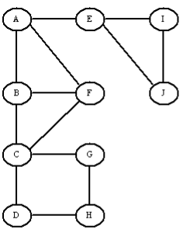
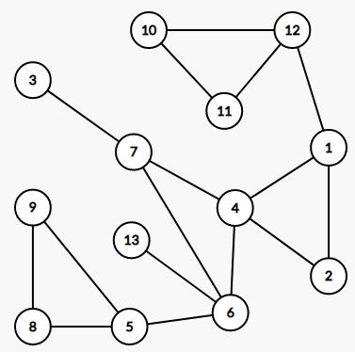
Breadth-first Search Ex.
38

Slide 39
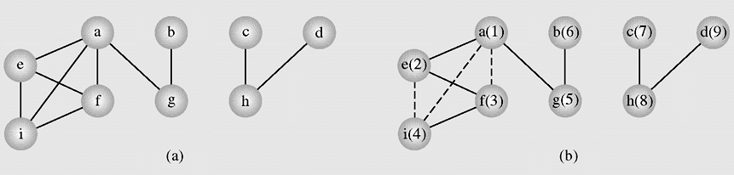
Depth-first Traversal
In the depth-first search algorithm, at first selected vertex v is visited and then each unvisited vertex adjacent to v is visited by depth-first search. If there are still some unvisited vertices in the graph, the traversal continues restarting for one of the unvisited vertices.
An example of application of the depthFirstSearch()algorithm to a graph

Slide 40
Depth-First Search algorithm
DFS-visit (Graph G, Vertex u)
{ the vertex u is painted gray
for all white successors v of u
{ dfs-visit(G, v)
}
u is painted black
}
DFS (Graph G)
{ all vertices of G are first painted white
DFS-visit(G, root of G)
}
The idea is the same, but we now use a stack instead of a queue. With recursion of course, so the stack management is all done by Java.
Here is a brief description of the DFS algorithm:
DFS on a graph with n vertices and m edges takes O(n + m ) time

Slide 41
Depth-First Traverse code
void visit(int i)
{System.out.print(" " + v[i]);
}
void depthFirst(boolean visited[], int i)
{visit(i);visited[i] = true;
int j;
for(j=0;j<n;j++)
if(a[i][j]>0 && (!visited[j]))
depthFirst(visited,j);
}
void depthFirst(int k)
{int i; boolean [] visited = new boolean[20];
for(i=0;i<n;i++) visited[i]=false;
depthFirst(visited,k);
for(i=0;i<n;i++)
if(!visited[i])
depthFirst(visited,i);
System.out.println();
}

Slide 42
Depth-first Search Ex.
42

Slide 43
Shortest Path problem
43
The problem: find the shortest path between a pair of vertices of a graph
The graph: may contain negative edges but no negative cycles
A representation: a weighted matrix where W(i,j) = 0 if i=j. W(i,j) = ∞ if there is no edge between i and j. W(i,j) = weight of the edge (i,j)
Notes:
43

Slide 44
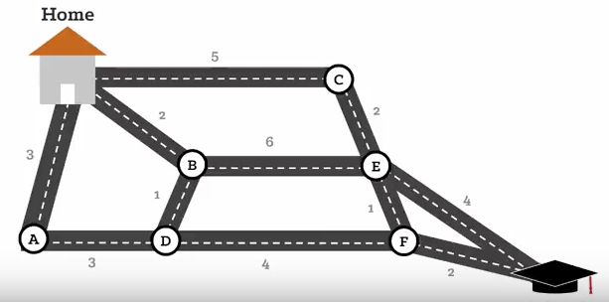
Shortest Path problem
 | H | A | B | C | D | E | F | S
H | 0 | 3 | 2 | 5 | 0 | 0 | 0 | 0
A | 3 | 0 | 0 | 0 | 3 | 0 | 0 | 0
B | 2 | 0 | 0 | 0 | 1 | 6 | 0 | 0
C | 5 | 0 | 0 | 0 | 0 | 2 | 0 | 0
D | 0 | 3 | 1 | 0 | 0 | 0 | 4 | 0
E | 0 | 0 | 6 | 2 | 0 | 0 | 1 | 4
F | 0 | 0 | 0 | 0 | 4 | 1 | 0 | 2
S | 0 | 0 | 0 | 0 | 0 | 4 | 2 | 0
44
Notes:
44

Slide 45
Dijkstra's Algorithm - 1
45
The main idea in applying the greedy-method pattern to the single-source shortestpath problem is to perform a “weighted” breadth-first search starting at the source vertex s. In particular, we can use the greedy method to develop an algorithm that iteratively grows a “cloud” of vertices out of s, with the vertices entering the cloud in order of their distances from s. Thus, in each iteration, the next vertex chosen is the vertex outside the cloud that is closest to s.
Data Structures and Algorithms in Java
45/36
Notes:
Image source: http://en.wikipedia.org/wiki/File:Dijksta_Anim.gif
45

Slide 46
Dijkstra's Algorithm - 1
46
The algorithm terminates when no more vertices are outside the cloud (or when those outside the cloud are not connected to those within the cloud), at which point we have a shortest path from s to every vertex of G that is reachable from s. This approach is a simple, but nevertheless powerful, example of the greedy-method design pattern. Applying the greedy method to the single-source, shortest-path problem, results in an algorithm known as Dijkstra’s algorithm.
Data Structures and Algorithms in Java
46/36
Notes:
Image source: http://en.wikipedia.org/wiki/File:Dijksta_Anim.gif
46

Slide 47
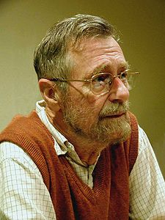
Dijkstra's Algorithm - 2
47
DijkstraAlgorithm
(non-gegative weighted simple digraph,
vertex first)
for all vertices v:
currDist(v) = ∞;
currDist(first) = 0;
toBeChecked = V (all vertices);
checked = empty;
while toBeChecked is not empty
u = a vertex in toBeChecked with min.currDist(u);
remove u from toBeChecked and add to checked;
for all vertices v adjacent to u and in toBeChecked
if (currDist(v) > currDist(u) + weight(edge(uv)))
currDist(v) = currDist(u) + weight(edge(uv))
predeccessor(v) = u;
Notes:
Image source: http://en.wikipedia.org/wiki/File:Dijksta_Anim.gif
47

Slide 48
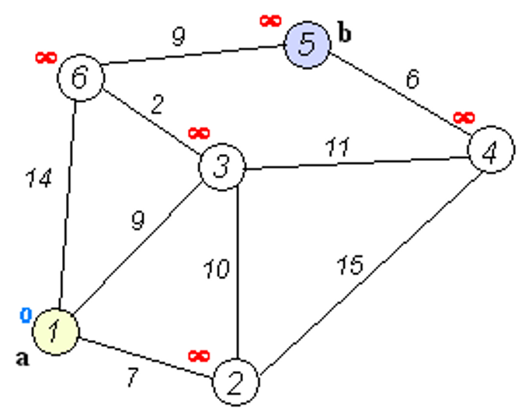
DijkstraAlgorithm
(non-gegative weighted simple digraph,
vertex first)
for all vertices v:
currDist(v) = ∞;
currDist(first) = 0;
toBeChecked = V (all vertices);
checked = empty;
while toBeChecked is not empty
u = a vertex in toBeChecked with min.currDist(u);
remove u from toBeChecked and add to checked;
for all vertices v adjacent to u and in toBeChecked
if (currDist(v) > currDist(u) + weight(edge(uv)))
currDist(v) = currDist(u) + weight(edge(uv))
predeccessor(v) = u;

Slide 49
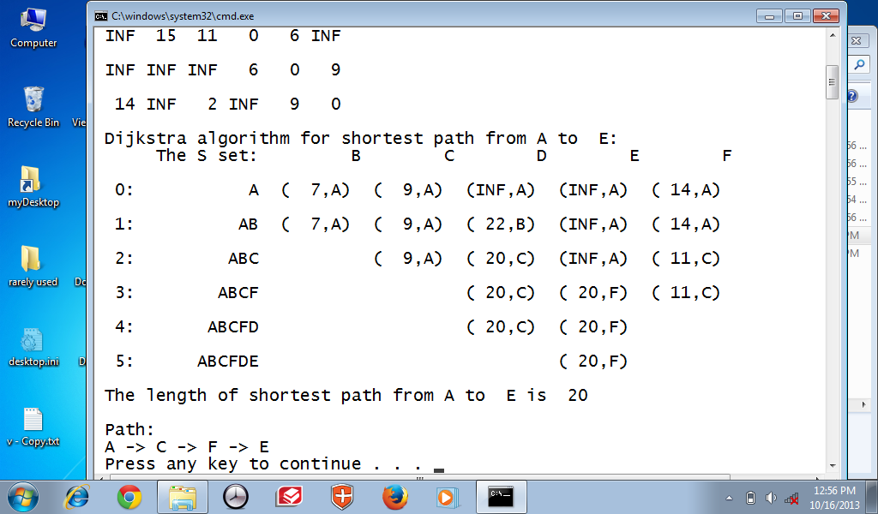

Dijkstra's Algorithm example - 1
A=1, B=2, C=3, D=4, E=5, F=6
49
Dijkstra’s algorithm keeps two sets of vertices:
S Vertices whose shortest paths have already been determined V-S Remainder
Also
dis Best estimates of shortest path to each vertex pre Predecessors for each vertex
int [][] b = {
{ 0, 7, 9, 99, 99, 14},
{ 7, 0, 10, 15, 99, 99},
{ 9, 10, 0, 11, 99, 2},
{99, 15, 11, 0, 6, 99},
{99, 99, 99, 6, 0, 9},
{14, 99, 2, 99, 9, 0}
};
Notes:
Image source: http://en.wikipedia.org/wiki/File:Dijksta_Anim.gif
49

Slide 50

Dijkstra's Algorithm example - 2
The complexity of Dijkstra's algorithm is O(|V|²). This algorithm is not general enough in that it may fail when negative weights are used in graphs.

Slide 51
Floyd Algorithm
All pairs shortest path
51
The problem: find the shortest path between every pair of vertices of a graph
The graph: may contain negative edges but no negative cycles
1. D = W // initialize D array to W [ ] 2. P = 0 // initialize P array to [0] 3. for k = 1 to n 4. do for i = 1 to n 5. do for j = 1 to n 6. if (D[ i, j ] > D[ i, k ] + D[ k, j ] ) 7. then { D[ i, j ] = D[ i, k ] + D[ k, j ] 8. P[ i, j ] = P[k,j];
}
Complexity O(|V|³)
Notes:
This algorithm uses label-correcting method
51

Slide 52

Notes:
https://www.geeksforgeeks.org/floyd-warshall-algorithm-dp-16/

Slide 53


Slide 54



Slide 55



Slide 56



Slide 57



Slide 58



Slide 59


Slide 60

Floyd Algorithm example

Slide 61


Slide 62


Slide 63


Slide 64


Slide 65

Floyd Algorithm example

Slide 66

The final distance matrix and P
Floyd Algorithm example (cont.)
The values in parenthesis are the non zero P values.

Slide 67

Dijkstra's Algorithm Exercise

Slide 68
Dijkstra's Algorithm Exercise

Slide 69

Dijkstra's Algorithm Exercise
Given a weighted graph below and you are using the Dijkstra algorithm to find the shortest path from the vertex A to the vertex B. What are the correct order of vertices selected into the set S until the vertex B is selected? (Each step a vertex with minimal current distance is selected into S)

Slide 70


Dijkstra's Algorithm Exercise
What is the path with the shortest path (prefers the least number of vertices) from vertex A to vertex G on the following graph?

Slide 71


Exercise
1. What is the breadth-first traversal from the vertex D of a graph below? (visit nodes in ABC order if there are some nodes having the
same selection ability)
A. D, B, C, F, A, E, G, H
B. D, B, C, F, A, E, G
C. D, C, F, B, E, A, G, H
D. D, C, B, F, A, G, E, H
2. Given a weighted graph below and you are using the Dijkstra algorithm to find the shortest path from the vertex A to the vertex C.
What are the correct order of vertices selected into the set S until the vertex C is selected? (Each step a vertex with minimal current distance is selected into S).
A. A, B, C
B. A, B, E, C
C. A, B, D, E, C
D. A, B, D, C DiB; “ DjB;C c

Slide 72

Exercise
Given a weighted graph below and you are using the Dijkstra algorithm to find the shortest path from the vertex A to the vertex F. What are the correct order of vertices selected into the set S until the vertex F is selected? (Each step a vertex with minimal current distance is selected into S).
A. A, C, D, F
B. A, B, C, E, D, F
C. A, B, C, E, F
D. A, C, E, F o

Slide 73







Exercise
Given the graph G = (V.E) and X is a vertex of G. Suppose there exists at least one Hamilton Cycle for the graph. The following is a backtracking algorithm for finding
the first Hamilton cycle from the vertex X:
declare an empty array H (which will contain Hamilton cycle)
(1) Put the vertex X to H
(2) Check if H is a Hamilton cycle then stop.
else go to (3)
(3) Consider the last vertex Y in H.
iIf there is/are vertex(es) adjacent to Y: select the first adjacent vertex Z (by alphabet order) and put it to H.
If there no adjacent vertex, remove Y from H and denote it as a bad selection (so you do not select it in the same way again).
Go to (2).
Suppose a G is given below (view picture). Which of the followings is the Hamilton cycle from the vertex C. created by above algorithm?
A. C.A.B. E. D. F. C
B. C.E.B. D. A. F. C
C. C.F.D. E. B. A. C
D. C.E. D.F.A. B. C
E. C.B.A.F.D. E. C

Slide 74




Exercise
Consider a graph below. One cut-edge in the graph is

Slide 75


Exercise
A graph that has neither self-loop nor parallel edges are called

Slide 76



Exercise
The minimum number of edges required to create a cyclid graph (the graph containg a cycle) of n vertices is

Slide 77
Summary
77
Graph Introduction
Graph definition
Graph Terminology
Graph applications
Graph Representation
Graph Traversals
Shortest Paths
Dijsktra algorithm
Floyd algorithm

Slide 78
Reading at home
Text book: Data Structures and Algorithms in Java
14 Graph Algorithms 611
14.1 Graphs - 612
14.1.1 The Graph ADT - 618
14.2 Data Structures for Graphs - 619
14.2.1 Edge List Structure - 620
14.2.2 Adjacency List Structure - 622
14.2.4 Adjacency Matrix Structure - 625
14.3 Graph Traversals - 630
14.3.1 Depth-First Search - 631
14.3.3 Breadth-First Search - 640
14.6 Shortest Paths - 651
14.6.1 Weighted Graphs - 651
14.6.2 Dijkstra’s Algorithm - 653

